Slide 1
SC37 report on
Biometric Data Format and Related Standards
Christoph Busch
- ISO/IEC JTC1/SC37 WG3 Convenor -
  January meeting
  2025-01-17

Slide 2
Meetings Report
Bertinoro Meeting
  2024-07-15 to 2024-07-19
  78 participants
Wellington Meeting
  2025-01-13 to 2025-01-16
  71 participants
Christoph Busch
    Standards
2025

Slide 3
Biometric Data Interchange Formats
Christoph Busch
    Standards
2025

Slide 4
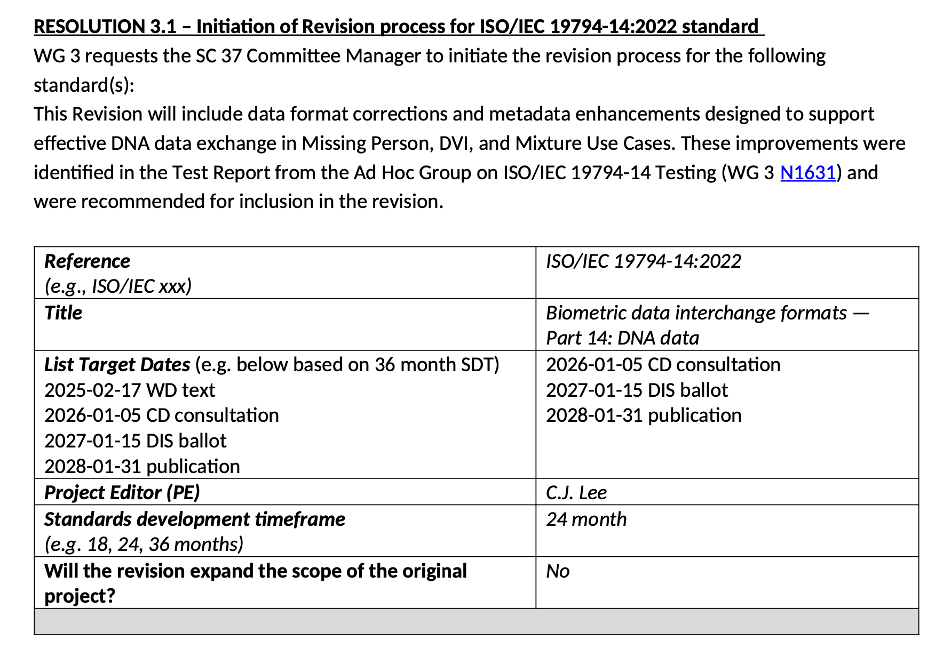
G2 development
Status in 2025
  Revision of ISO/IEC 19794-14
Christoph Busch
    Standards
2025

Slide 5

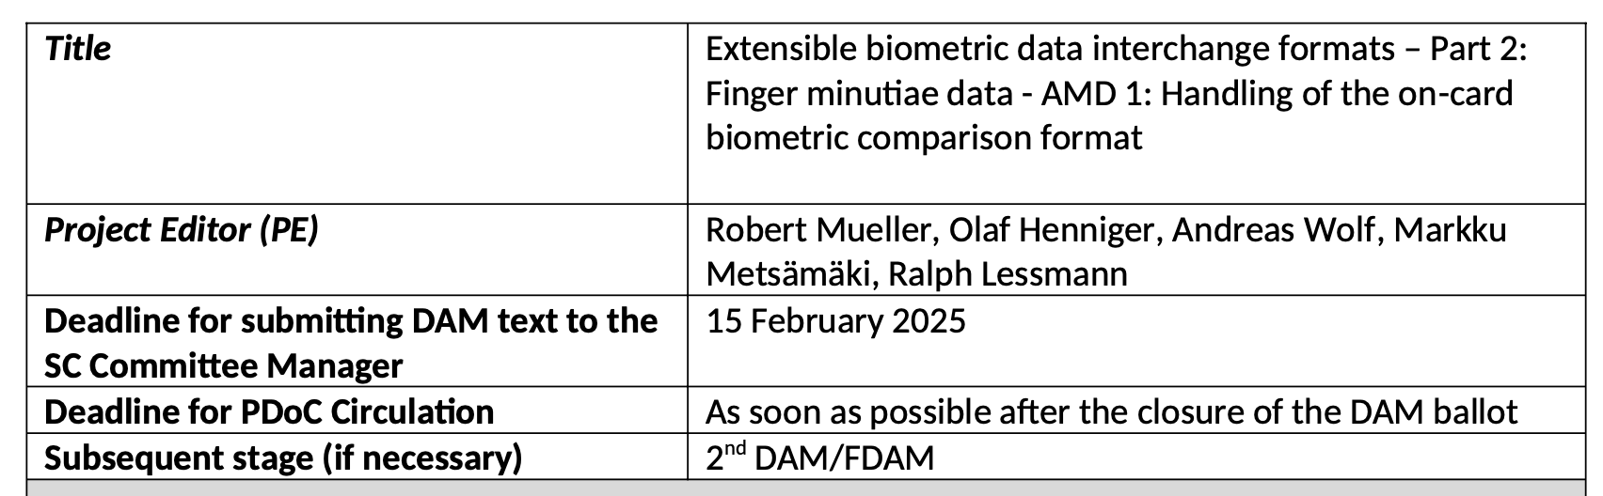
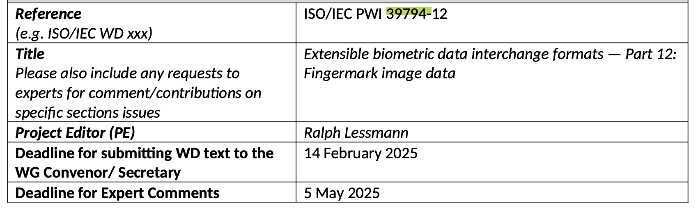
G3 development
Status in 2025
of ISO/IEC 39794
  Several parts are published
    Part 1 (Framework)
    Part 2 (Finger minutiae)
    Part 4 (Finger image data)
    Part 5 (Face image data)
    Part 6 (Iris image data)
    Part 9 (Vascular image data)
    Part 16 (Full body image data)
    Part 17 (Gait image sequence)
  Parts under development
    Part 12 (Fingermark image data)
Christoph Busch
    Standards
2025

Slide 6

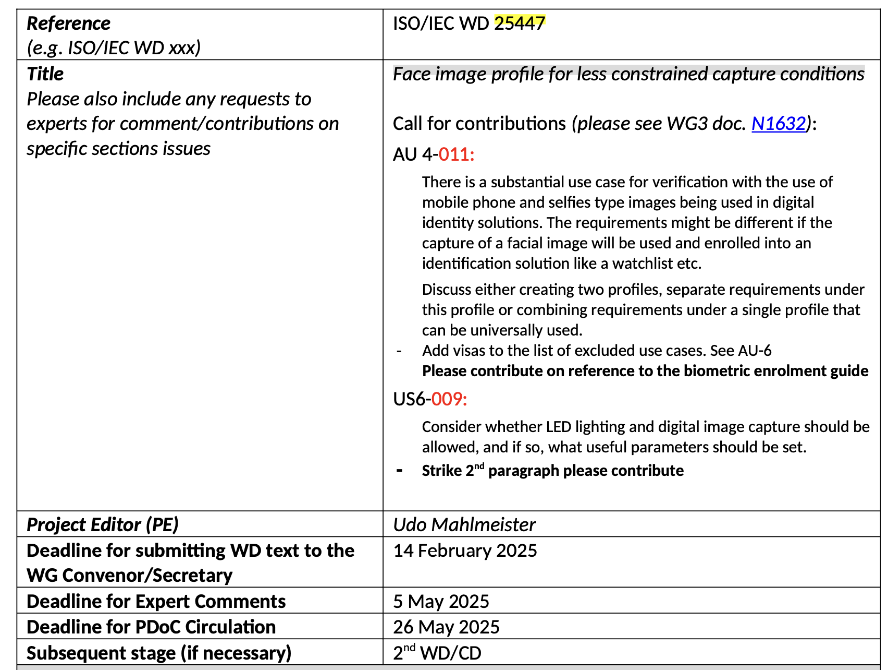
G3 development
Status in 2025 of ISO/IEC 25447
Face image profile for less constrained capture conditions
Christoph Busch
    Standards
2025

Slide 7
Related Standards
Christoph Busch
    Standards
2025

Slide 8
Biometric Sample Quality
Status in 2025 of 29794
  ISO/IEC 29794:2024 Part 1: Framework (published)
    definition of quality score, quality component, quality measure, EDC
  ISO/IEC 29794:2024 Part 4: Finger image data (published)
    the reference implementation NFIQ2.3 is in GitHub
    https://github.com/usnistgov/NFIQ2
  ISO/IEC 29794 Part 5: Face image data (FDIS)
    the reference implementation OFIQ1.0 is in GitHub
    https://github.com/BSI-OFIQ/OFIQ-Project
    Specific Image Defect Detection (SIDD) test report
    https://pages.nist.gov/frvt/reports/quality_sidd/frvt_quality_sidd_report.pdf
  ISO/IEC 29794 Part 6: iris image data
  ISO/IEC 29794 Part 9: vascular image data
  ISO/IEC 29794 Part 12: fingermark image data
Christoph Busch
    Standards
2025

Slide 9
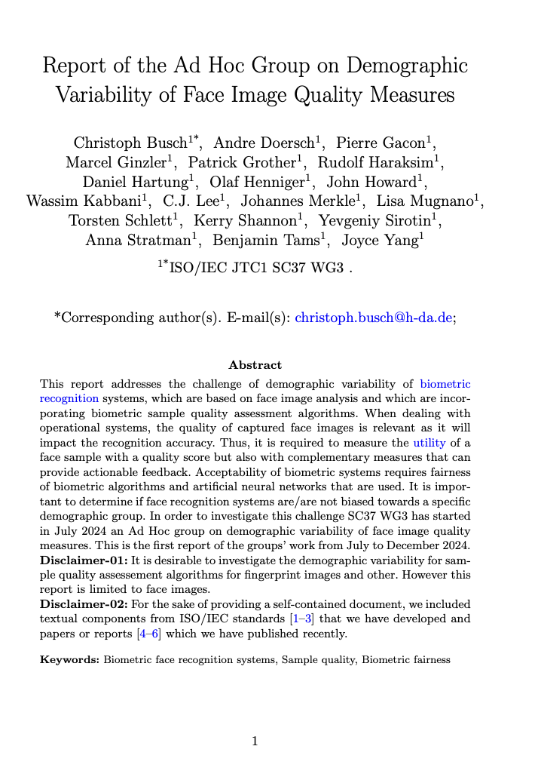
Biometric Sample Quality
Status in 2025
Content of the report WG3 N1617
  Introduction
  Face image quality
  Biometric fairness overview
  Demographic variables of interest
  Quality measures of interest
  Demographic variability reports
  Methodology
  Conclusion and recommendations
Christoph Busch
    Standards
2025

Slide 10
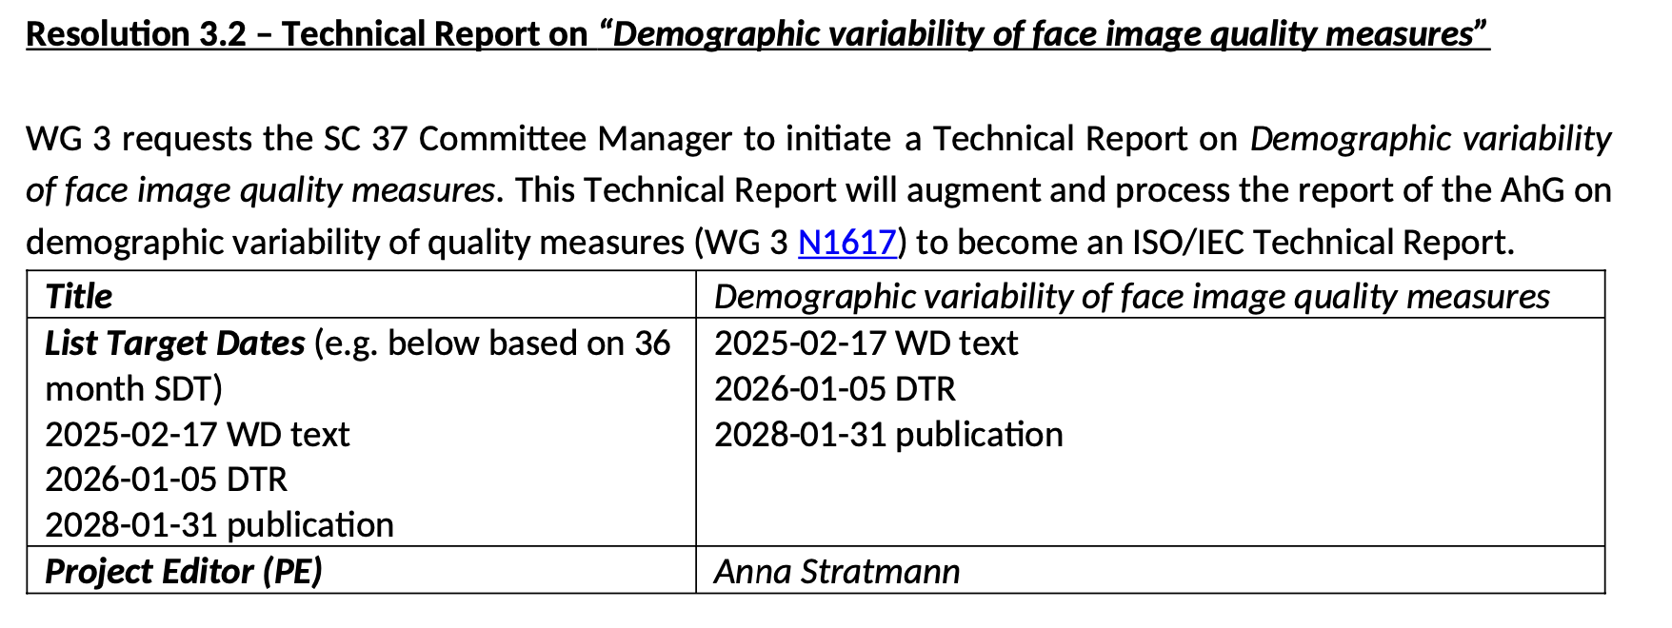
Biometric Sample Quality
Status in 2025
Part of the content of the report WG3 N1617
  transferred to a Technical Report
Christoph Busch
    Standards
2025

Slide 11
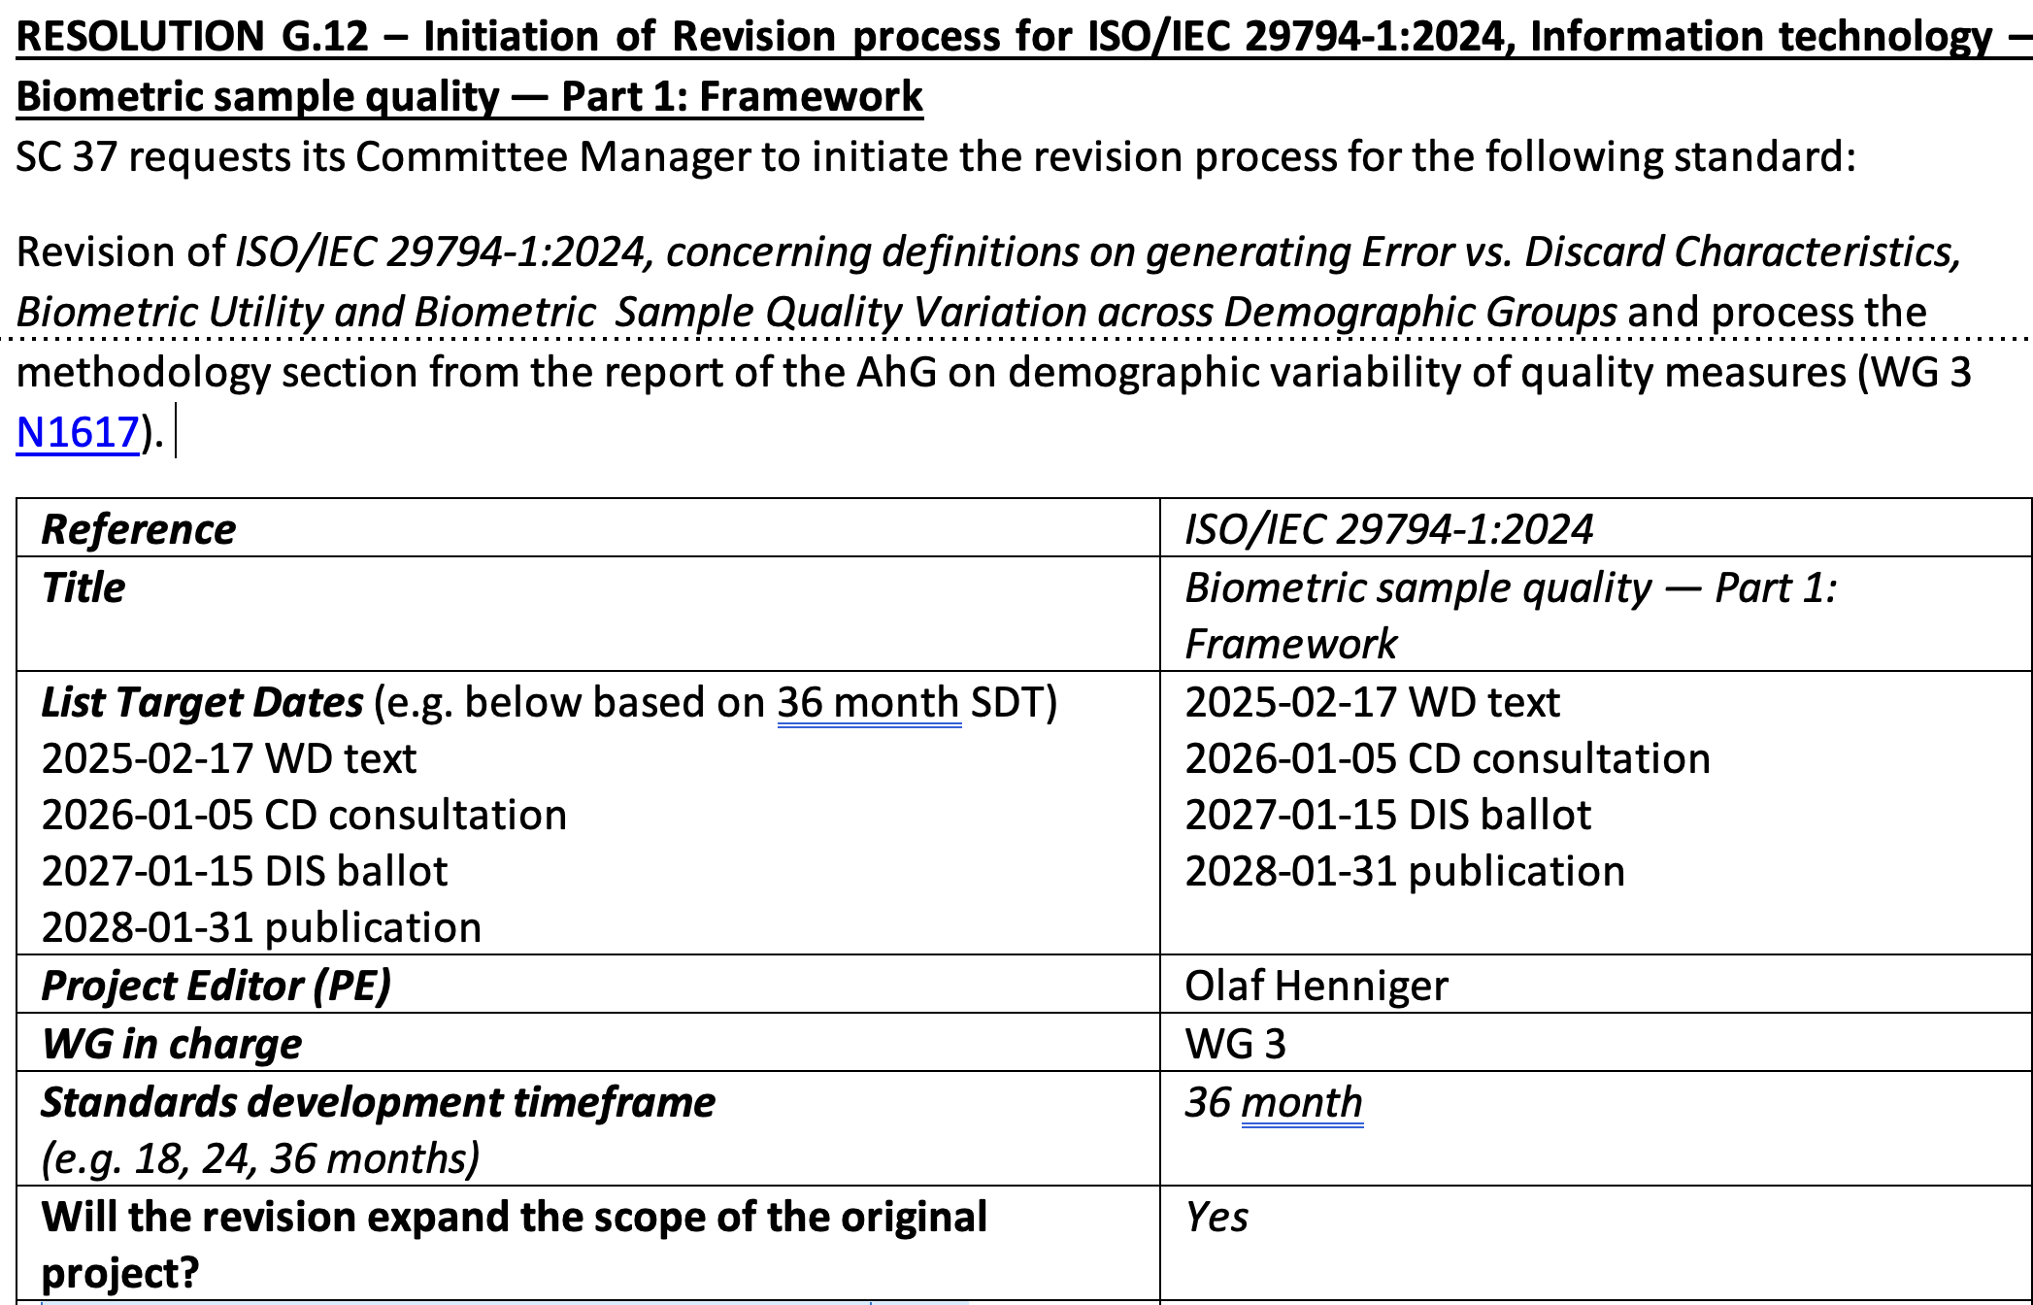
Biometric Sample Quality
Status in 2025
  Revision of ISO/IEC 29794 - Part 1: Framework
Christoph Busch
    Standards
2025

Slide 12
Biometric Sample Quality
Status in 2025
  Scope of ISO/IEC 29794:2024 - Part 1: Framework
  This document establishes the following items for any or all biometric sample types as necessary:
    terms and definitions that are useful in the specification and use of quality measures;
    purpose and interpretation of biometric quality scores;
    motivation for developing biometric sample datasets for the purpose of quality score normalization;
    format for exchange of quality assessment algorithm results;
    methods for aggregation of quality scores;
    methods for evaluating the efficiency of quality assessment algorithms.
Christoph Busch
    Standards
2025

Slide 13
Biometric Sample Quality
Status in 2025
  New Scope of rev ISO/IEC 29794- Part 1: Framework
  This document establishes the following items for any or all biometric sample types as necessary:
    terms and definitions that are useful in the specification and use of quality measures;
    purpose and interpretation of biometric quality scores;
    motivation for developing biometric sample datasets for the purpose of quality score normalization;
    format for exchange of quality assessment algorithm results;
    methods for aggregation of quality scores;
    methods for evaluating the efficiency of quality assessment algorithms;
    methods for reporting demographic variability of quality measures
Christoph Busch
    Standards
2025

Slide 14
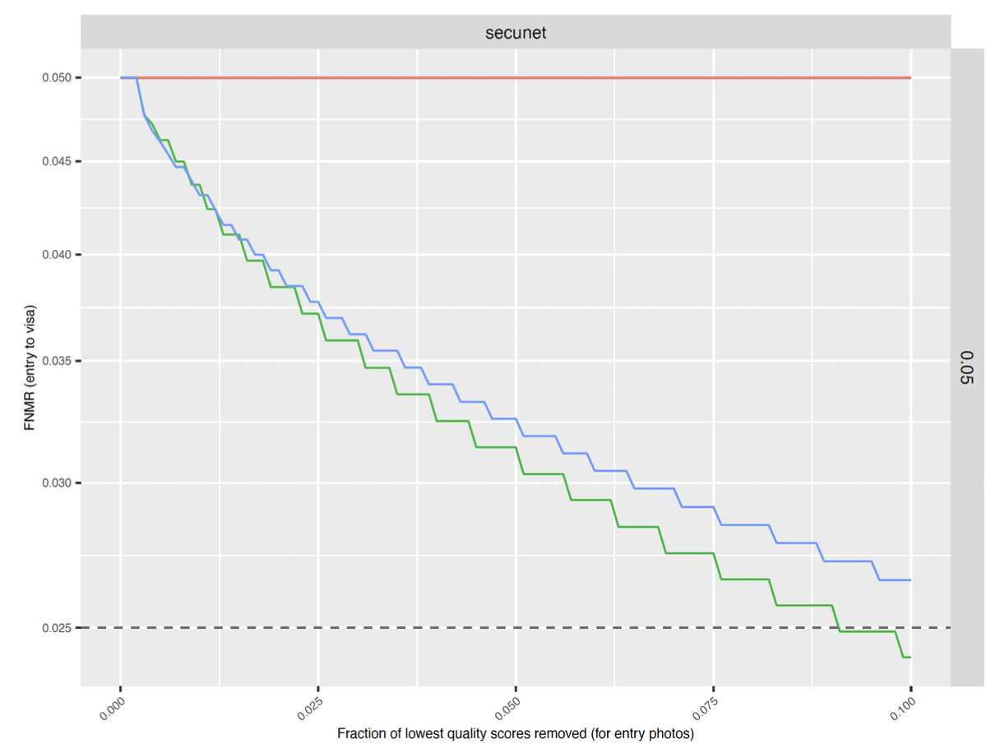
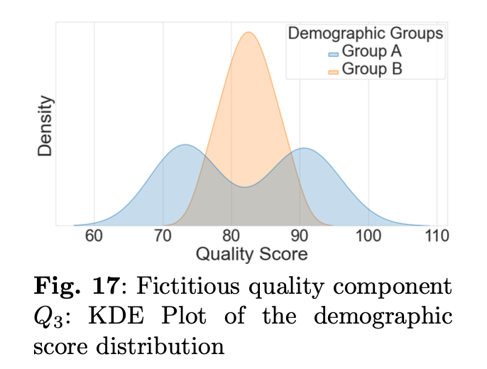
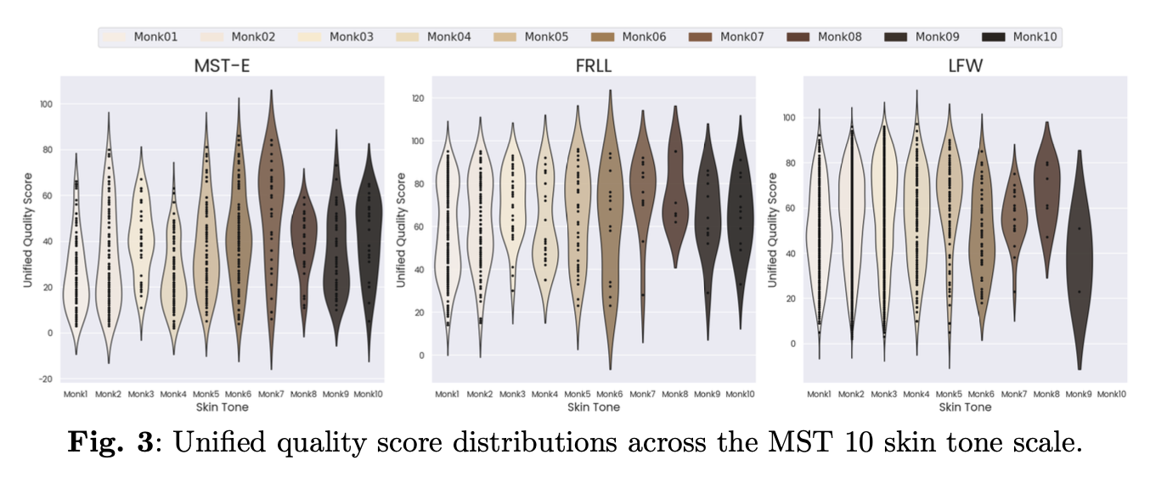
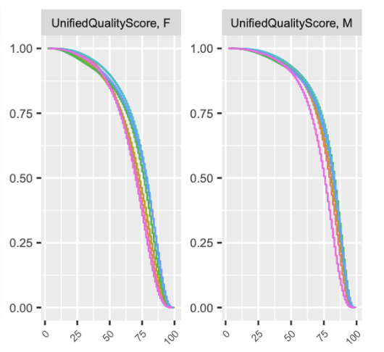
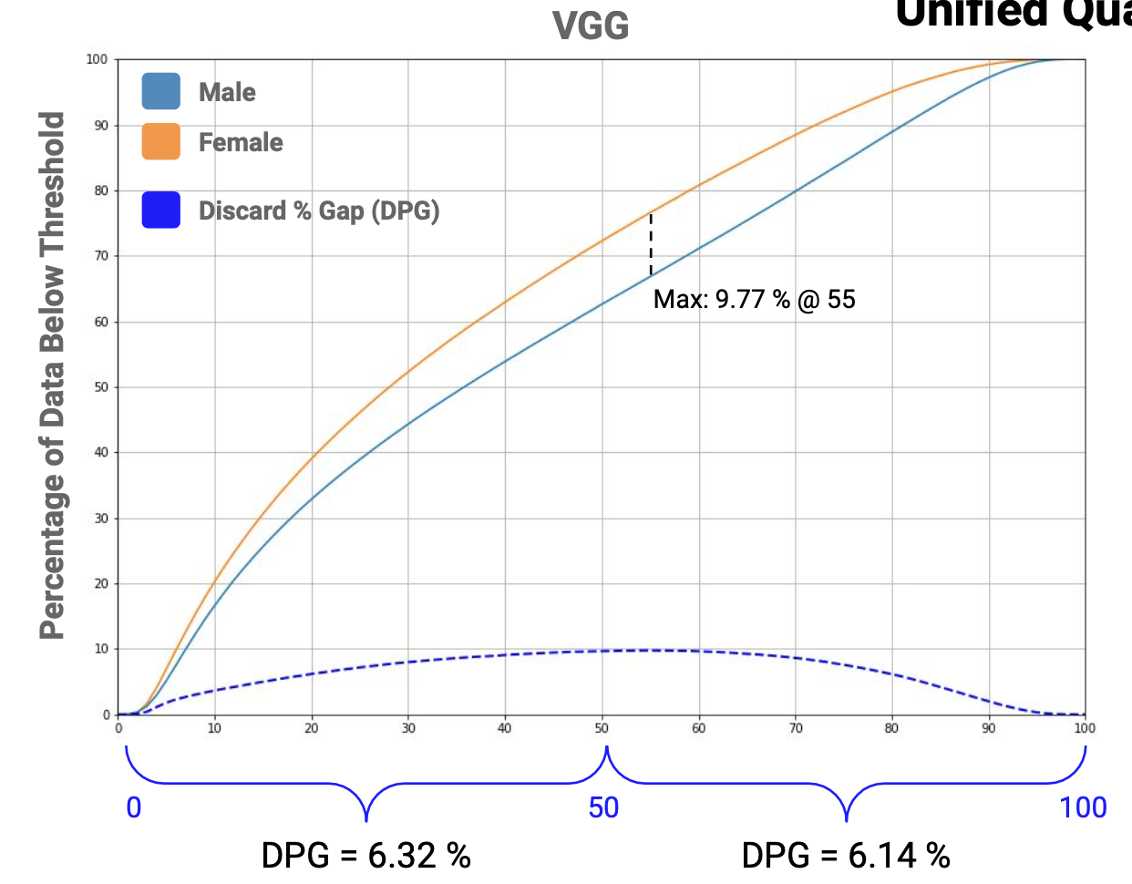
Biometric Sample Quality
Status in 2025
  methods for reporting demographic variability
  of quality measures.
  Select from these candidates
    EDC curves
    Kernel density estimate curves
    Violin plots
    Cumulative score distributions
    Discard gap curves
Christoph Busch
    Standards
2025

Slide 15
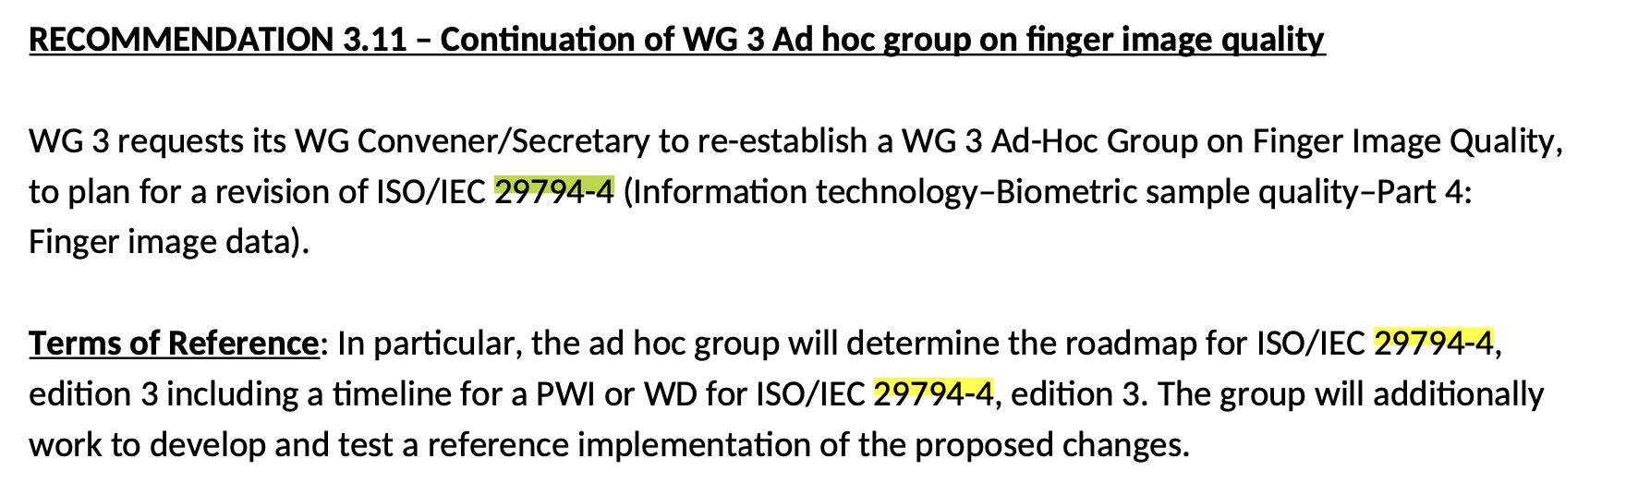
Biometric Sample Quality
Status in 2025
  ISO/IEC 29794 - Part 4: Finger image data
Christoph Busch
    Standards
2025

Slide 16
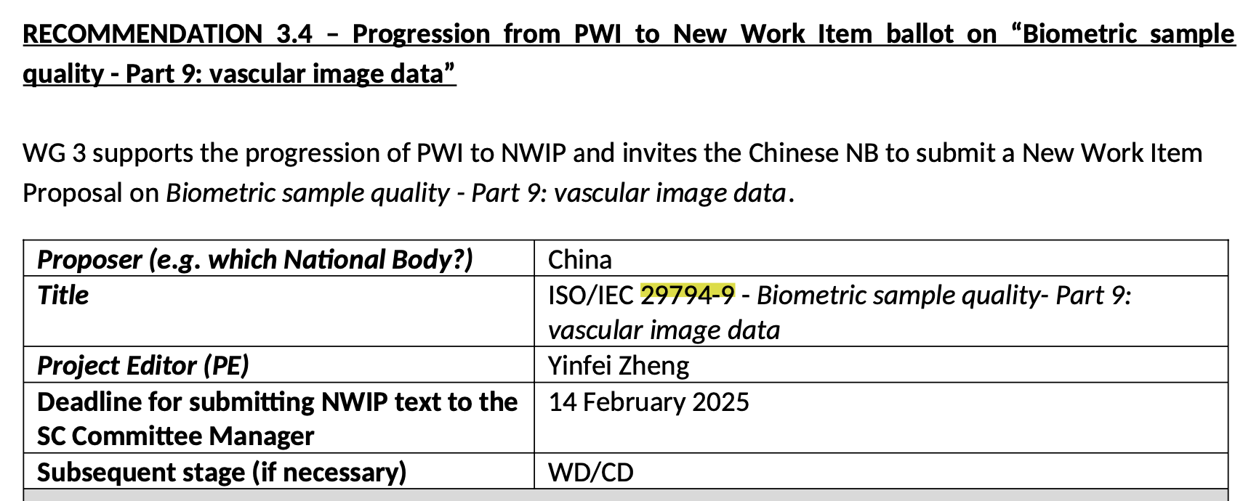
Biometric Sample Quality
Status in 2025
  NWIP ISO/IEC 29794 Part 9: Vascular image data
Christoph Busch
    Standards
2025

Slide 17
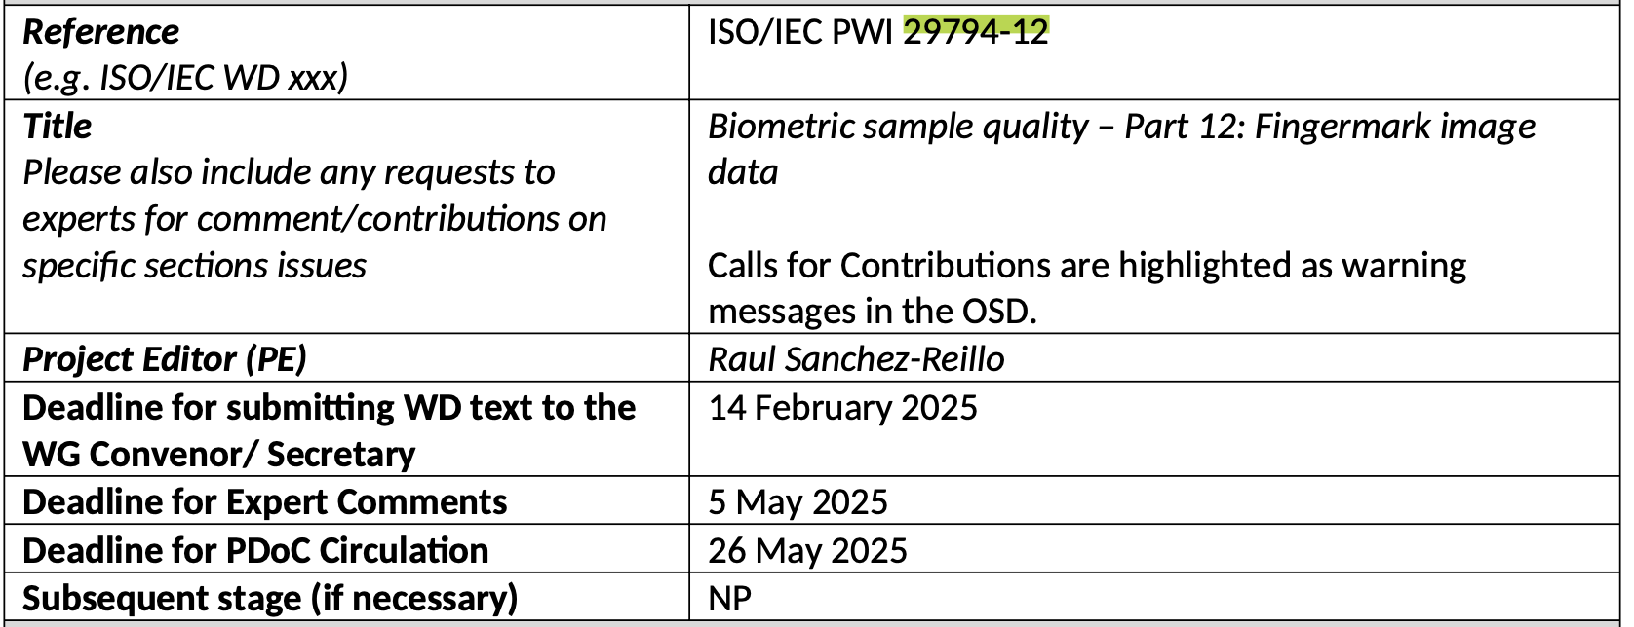
Biometric Sample Quality
Status in 2025
  ISO/IEC 29794 PWI Part 12: Fingermark image data
Christoph Busch
    Standards
2025

Slide 18
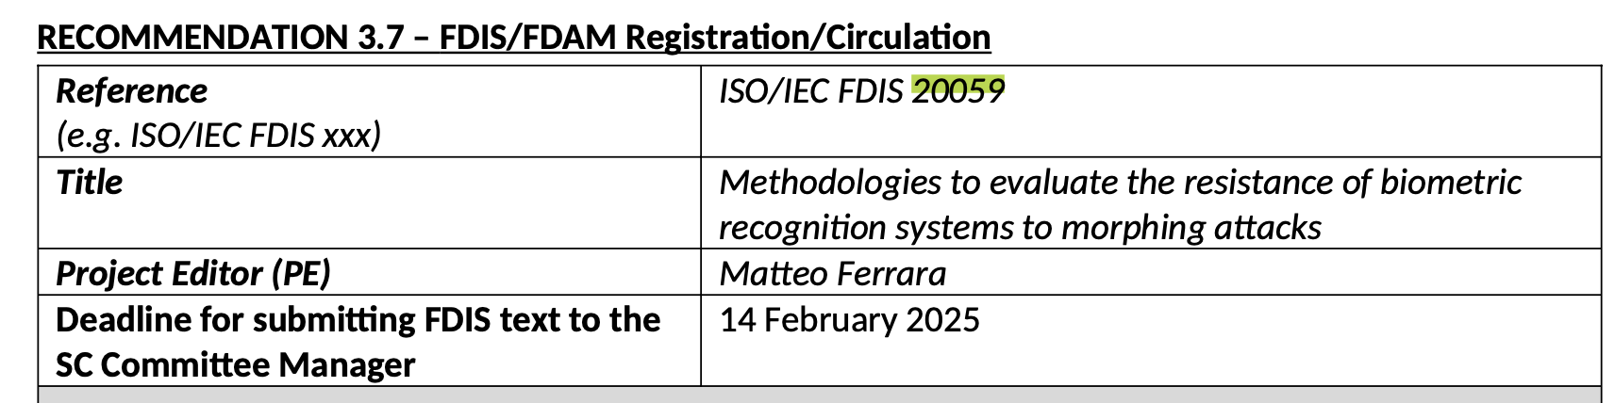
Morphing Attack Potential
Status in 2025 on ISO/IEC FDIS 20059
  Methodologies to evaluate the resistance of biometric recognition systems to morphing attacks
Christoph Busch
    Standards
2025

Slide 19
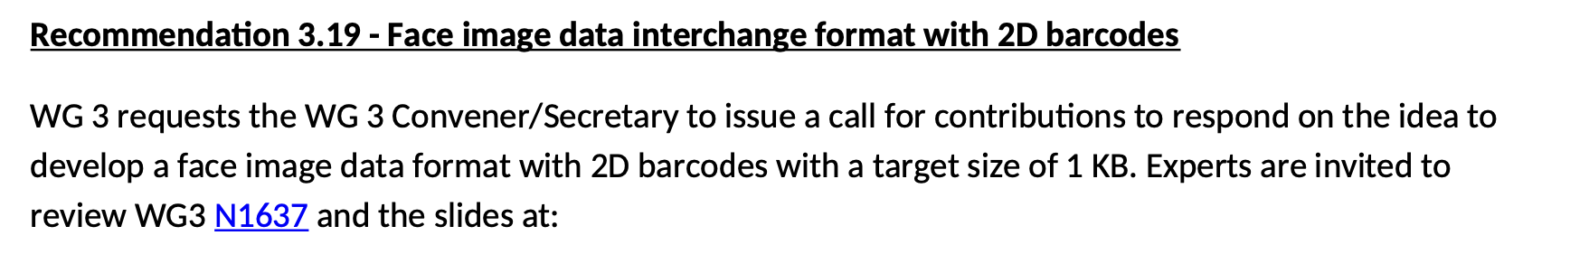
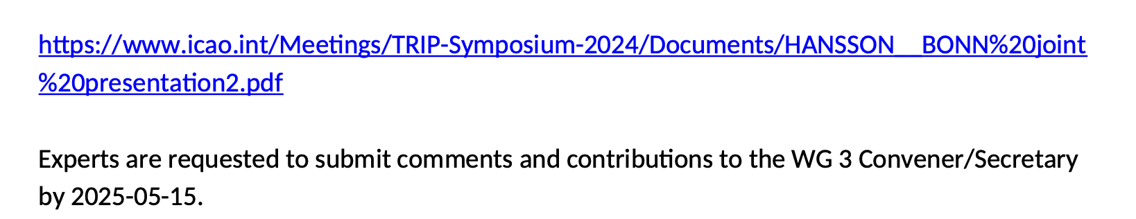
WG3 Roadmap SD14-3
Status in 2025 on future projects
  Face image data interchange format with 2D barcodes
Christoph Busch
    Standards
2025

Slide 20
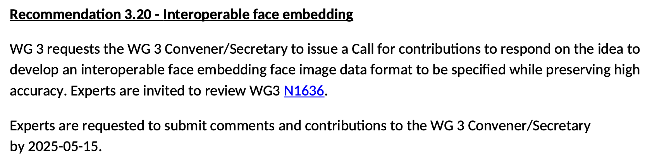
WG3 Roadmap SD14-3
Status in 2025 on future projects
  Interoperable face embedding
Christoph Busch
    Standards
2025

Slide 21
Thanks
Many thanks
  to the sponsors
    for meetings facilities and social events
  to the editors
  to the delegates
Christoph Busch
    Standards
2025

Slide 22
References
Web
  Convenors website with latest news and slides
  http://www.christoph-busch.de/standards-sc37wg3.html
  ISO/IEC JTC SC37
  http://isotc.iso.org/livelink/livelink?func=ll&objId=2262372&objAction=browse&sort=name
  Published ISO/IEC Standards
  http://www.iso.org/iso/iso_catalogue/catalogue_tc/catalogue_tc_browse.htm?commid=313770&published=on
Christoph Busch
    Standards
2025

